Slide 1
Herbert Simon (1916– 2001) was “an American political scientist,economist, sociologist, psychologist, and professor—most notably at Carnegie Mellon University—whose research ranged across the fields of cognitive psychology, cognitive science, computer science, public administration, economics, management, philosophy of science, sociology,and political science”.
Alan Newell (1927 – 1992) was a long term collaborator of Simon at CMU.He designed the language Information Processing Language (IPL) in whichLT was implemented.

Slide 2
Knowledge properties
Voluminous
Hard to characterize accurately
Constantly changing
Differs in data being organized in a way that corresponds to the ways it will be used

Slide 3
Knowledge should be represented in such a way that
Captures Generalization
Can be understood by people who provide it
Can be easily modified to correct errors and to reflect changes in the world
Can be used in many situations even if it is not totally accurate or complete
Can be used to help overcome sheer bulk by narrowing he range of possibilites

Slide 4
Simon and Newell
Simon and Newell went to become leading figures in AI research and
founded a strong group at CMU.
Their program General Problem Solver (GPS) was a pioneer in the
use of heuristics in search and adopted a human like approach called
means-ends-analysis.
Their work defined the Information-Processing approach for AI.
At CMU one shining example was the development of the SOAR
cognitive architecture by John Laird.

Slide 5
Physical Symbol Systems
Symbol : A perceptible something that stands for something else.
alphabet symbols, numerals, road signs, musical notation
Symbol System: A collection of symbols – a pattern
- words, arrays, lists, even a tune
Physical Symbol System: That obeys laws of some kind, a formal
system
- long division, an abacus, an algorithm

Slide 6
The Physical Symbol System Hypothesis
"A physical symbol system has the necessary and sufficient means for general intelligent action.“

Slide 7
Introductory Problem: Tic-Tac-Toe
Program 1:
1. View the vector as a ternary number. Convert it to a
decimal number.
2. Use the computed number as an index into
Move-Table and access the vector stored there.
3. Set the new board to that vector.

Slide 8
Efficient in terms of time.It could play an optimal game
Disadvantages
Lot of space
Lot of work specifying the moveable
Moveable determined and entered may have errors

Slide 9
PGM 2
Board: program1
2 : blank, 3 : X, 5 : O
Turn: game moves 1,2,3,.....
odd-numbered move : X
even-numbered move : O
Algorithm : 3 sub procedures
Make2: Board[5] or Board [2, 4, 6, or 8],
Posswin (p):Returns 0 if player p cannot win on next move otherwise return the number constituting the winning move 18 (3*3*2) for p = X
50 (5*5*2) for p = O
3) Go (n) : Move to Board [n]

Slide 10
STRATEGY FOR EACH TURN
Turn=1 Go (1)(upper left corner)
Turn=2 if Board[5] is blank,Go (5) else Go (1)
Turn=3 if Board[9] is blank,Go (9) else Go (3)
Turn=4 if Posswin(X) is not 0,then Go(Posswin(X)) else Go(Make2)

Slide 11
Turn=5 if Posswin(X) is not 0,then Go(Posswin(X)) else if
Go(Posswin(O)) is not 0 then
Go(Posswin(O)), else if
Board[7] is blank then
Go(7), else
Go(3)

Slide 12
Turn=6 if Posswin(O) is not 0,then Go(Posswin(0)) else if
Go(Posswin(X) is not 0 then
Go(Posswin(X)), else
Go(Make 2)

Slide 13
Turn=7 if Posswin(X) is not 0,then Go(Posswin(X)) else if
Go(Posswin(O) is not 0 then
Go(Posswin(O)), else
go anywhere that is blank

Slide 14
Turn=8 if Posswin(O) is not 0,then Go(Posswin(O)) else if
Go(Posswin(X) is not 0 then
Go(Posswin(X)), else
go anywhere that is blank
Turn =9 Same as Turn =7

Slide 15
COMMENTS
Less efficient than Program 1 (time)
More efficient (space)
More clarity (strategy)
Easier to change (strategy)
Cannot generalize the pgm knowledge to different domain.

Slide 16
PGM 2’
program 2 board
magic square 15
possible win check:
S = sum of two paired owned by a player
D = 15 – S
If the difference is not +ve or if it is greater than 9→not collinear ;so ignored
Otherwise if the square representing difference is blank ,move will produce a win

Slide 17
PGM 3
Data Structure
Board Position: nine element vector, list of board position from the next move and a number representing an estimate that leads to ultimate win for the player

Slide 18
To decide which set of board positions is best,do the following:
See if it is a win.If so call it best by giving highest possible rating
Otherwise consider all moves that opponent can make next. See which is worst for us, assume opponent makes that move. Whatever rating that move has, assign it to node we are considering
Best node is the one with highest rating

Slide 19
Comments
Extended to handle games more complicated than tic tac toe
It can be used in the situations where direct methods fail

Slide 20
QUESTION ANSWERING PROBLEM
i/p text→Russia massed troops on the Czech border
Dialogue 1
Q:Why did Russia do this?
A:Bcos Russia thought it could take political control on czechoslovakia by sending troops
Q:What should United States do?
A:The United States should intervene militarily

Slide 21
Dialogue 2
Q:Why did Russia do this?
A:Bcos Russia wanted to increase political influence over czechoslovakia
Q:What should United States do?
A:The United States should denounce Russian action in United Nations

Slide 22
Mary went shopping for a new coat. She found a red one she really liked. When she got home, she discovered that it went perfectly with her favorite dress
Q1:What did Mary go shopping for ?
Q2:What did Mary find that she liked?
Q3:Did Mary buy anything?

Slide 23
PGM1
DATASTRUCTURE
Question Pattern: Set of templates that match common question forms and produce patterns to be used match against inputs
Text: Input text stored as long character string
Question: The current question stored as character string

Slide 24
Algorithm
To answer a question ,do the following:
Compare each element of Question pattern against Question and use all those that match successfully to generate text of patterns
Pass each of these patterns through a substitution process that generates alternative forms of verb(go➔went)
Apply each of these text patterns to Text and collect all the resulting answers
Reply with the set of answers just collected

Slide 25
COMMENTS
Inadequate to answers the kinds of questions ppl could answer after reading a simple text

Slide 26
PGM 2
DataStructures
EnglishKnow: Description of words, grammar and appropriate semantic interpretation of a large enough subset of English to account for input text that system will see
Input Text:Character form

Slide 27
Structured Text:Structured reprsentation of input text
“She found a red one she really liked”
Event1
Instance:finding
Agent:Mary
Object:thing
Thing1
Instance:coat
Color:red
Event2
Instance:liking
Agent:much
Object:thing1

Slide 28
InputQuestion:Input question in the character form
StructQuestion:Structured representation of the user question

Slide 29
Algorithm2
Convert the InputText into the structured form
,using knowledge contained in EnglishKnow. The
answer a question to do the following:
Convert the question to the structured form ,using knowledge contained in EnglishKnow.
Match this structured form against Structured text
Return as the answer those parts of the text that match the requested segment of the question

Slide 30
COMMENTS
Approach is more meaning based than first and more effective
It answer most questions to which replies are contained in text
Mary walked up to the salesperson. She asked where the toy department was.
Mary walked up to the salesperson. She asked her if she needed any help

Slide 31
PGM 3
WorldModel: Structured representation of background world knowledge. Structure contains knowledge about objects, actions and situations that are described in the input text
Script
C(customer),S(Salesperson),M(Merchandise),D(dollars),L(a store)

Slide 32
Figure shows example about systems knowledge about shopping
1.C enters L
2.C begins looking around
3.C looks for a specific M 4.C looks for an interesting M
5.C asks S for help
6.
7.C find M’ 8.C fails to find M
9.C leave L 10.C buys M’ 11.C leave L 12.Goto step 2
13.C leave L
14.C takes M’

Slide 33
EnglishKnow:Same as pgm2
Input Text:Character form
IntegratedText: Structured representation of knowledge combined in the input text but combined now with other background related knowledge
InputQuestion:Input question in the character form
StructQuestion:Structured representation of the user question

Slide 34
Algorithm
Convert the InputText into the structured form
,using both knowledge contained in EnglishKnow
and that combined in WorldModel.To answer a question
to do the following:
Convert the question to the structured form as in pgm2 but use worldmodel to resolve ambiguities
Match this structured form against integrated text
Return as the answer those parts of the text that match the requested segment of the question

Slide 35
Comments
Powerful than both bcos it exploits more knowledge
Disadvantage
Missing out general inference mechanism

Slide 36
AI technique
Search
Use of knowledge
Abstraction

Slide 37
LEVEL OF MODEL
“What is out goal in trying to produce programs that do intelligent things that people do”
Divided into two classes
First class of pblm does not fit the definition of AI task(computer easily solve)
Example → EPAM(Elementary Perceiver and Memorizer)

Slide 38
Second class of problem fall more clearly to definition of AI task
To test psychological theories of human performance .pgm→PARRY
To enable computers to understand human reasoning
To enable people to understand computer reasoning
To exploit what knowledge to glean from people

Slide 39
Criteria for Success
Alan Turing proposed the method to determine whether machines can think .His method is known has Turing Test

Slide 40
Example
I:In the first line of your sonnet which reads ” Shall I compare thee to summer day” wouldnot “a spring day” do as well or better?
A:It wouldnot scan
I:How about “a winters day”That would scan all right
A:Yes,but nobody wants to be compared to a winters day.
I:Would you say Mr Pickwick reminded you of Christmas
A:In a way
I:Yet Christmas is a winter day and I donot think Mr Pickwick would mind the comparsion
A:I donot think you are serious. By a winter day one mean typical winter day rather than special one like Christmas

Slide 41
Chess
DENDRAL
Newspaper story
PGMMING LANGUAGES
LISP
PROLOG

Slide 42
To build a system to solve a particular problem we need four things
Define problem precisely
Analyze the problem
Isolate and represent the task knowledge
Choose best problem solving technique and apply them to particular problem

Slide 43
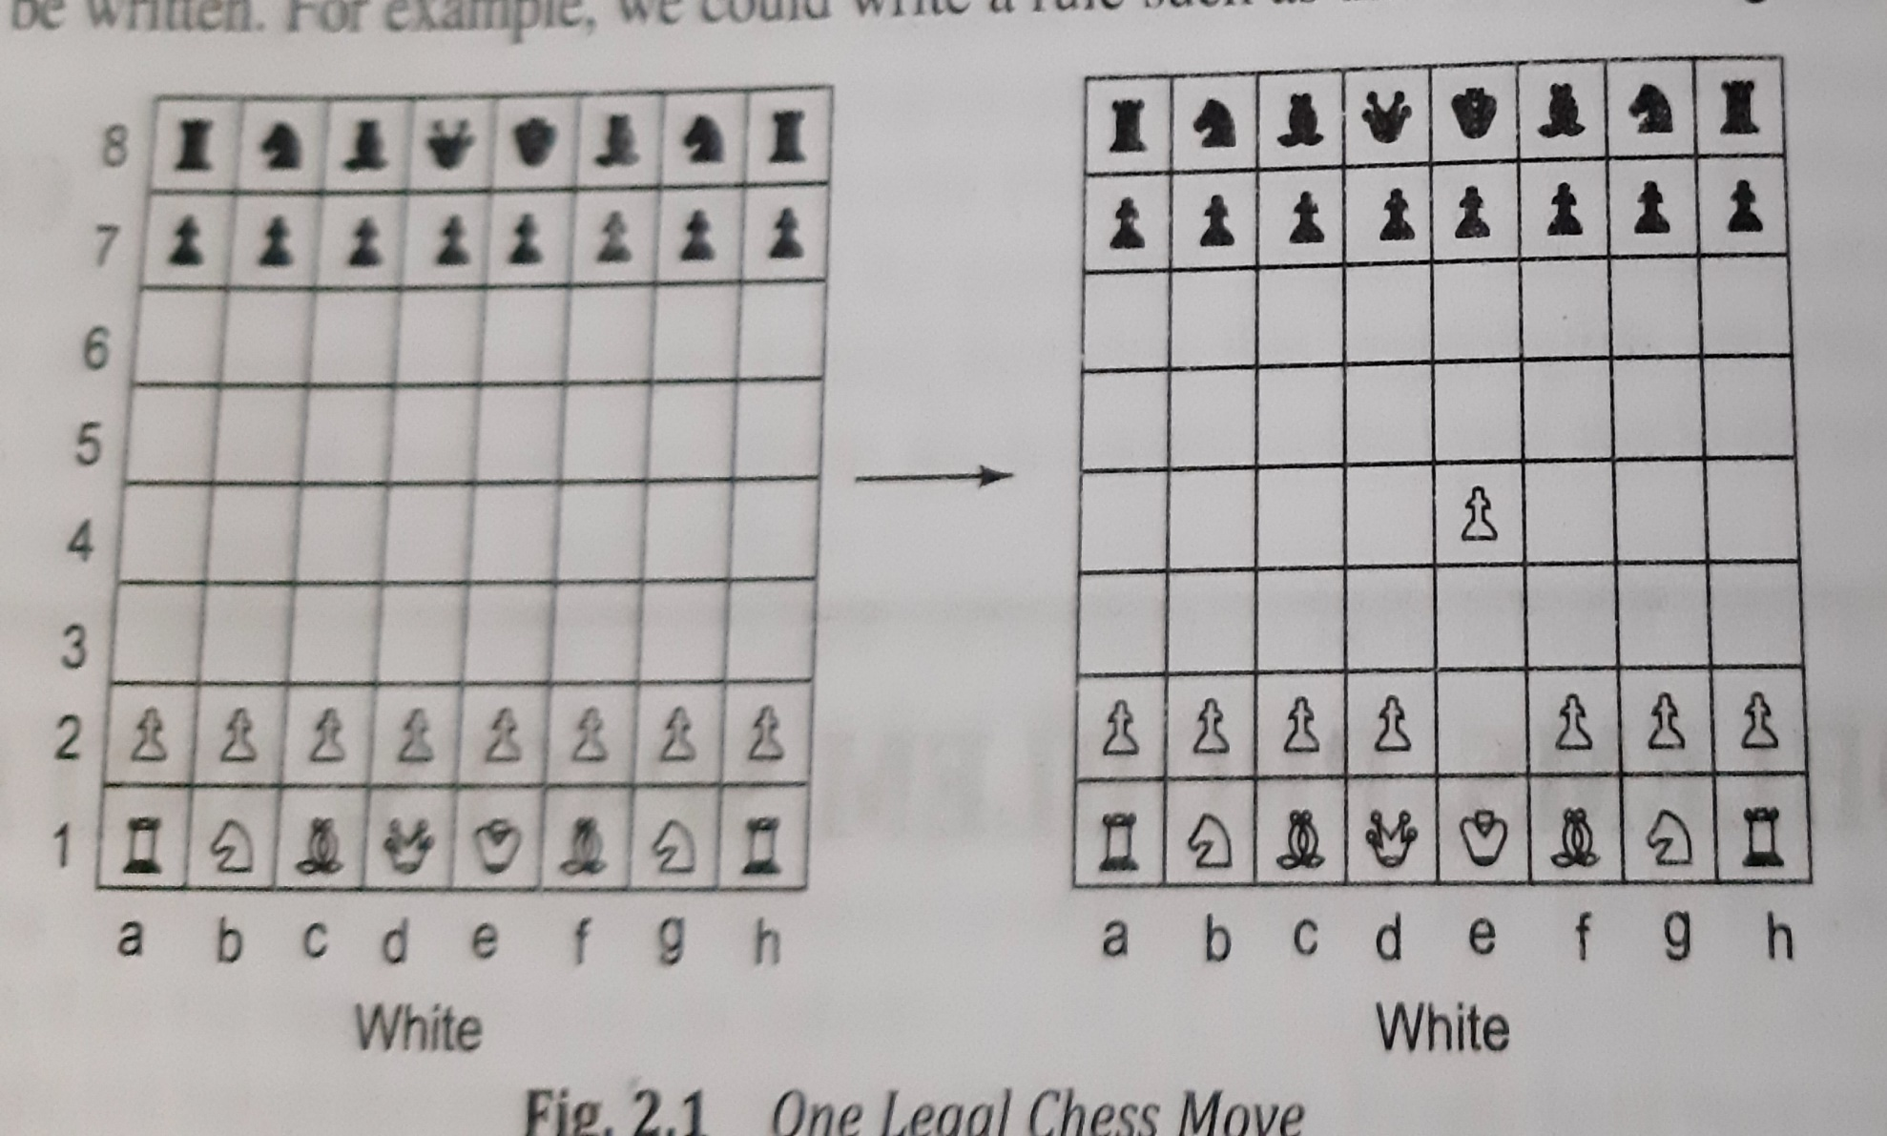

Slide 44
Defining problem as state space search
Problem “Play Chess”
Starting Position
Rules that define legal moves
Goal State(Board position that represent a win for one side or the other)

Slide 45
Example 1
Difficulty
It takes too long to supply set of such rules
Storing so many rules poses difficulties, no pgm could handle easily these rules

Slide 46
Example 2
White pawn at
Square(file e,rank 2)
AND
Square(file e,rank 3) is empty →move pawn from Square(file e,rank 2)
To Square(file e,rank 4)
AND
Square(file e,rank 4) is empty

Slide 47
State space representation structure
corresponds to structure of problem solving in
two important ways
It allows for a formal definition of problem as need to convert some given situation into some desired situation using set of permissible operations
It permits us to define the process of solving a particular problem as combination of known techniques and search

Slide 48
Water jug problem
You are given two jugs ,a 4-gallon one and a 3 gallon one. Neither has any measuring markers on it. There is pump that can be used to fill the jugs with water. How can u get exactly 2 gallons of water into 4 gallon jug?

Slide 49
Problem description in state space representation
State space: set of ordered pair of integers (x,y) such as x=0,1,2,3,4 and y=0,1,2,3
x->no of gallons of water in 4 gallon jug
y->no of gallons of water in 3 gallon jug
Start state:(0,0)
Goal state:(2,n)

Slide 50
Assumptions
We can fill the jug from the pump
Pour water out of jug onto the ground
Pour water from one jug to another
There are no measuring devices available

Slide 51
Operators
1 | (x,y) If x<4 | → | (4,y) | Fill the 4 gallon jug
2 | (x,y) If y<3 | → | (x,3) | Fill the 3 gallon jug
3 | (x,y) If x>0 | → | (x-d, y) | Pour some water out of 4 gallon jug
4 | (x,y) If y>0 | → | (x, y-d) | Pour some water out of 3 gallon jug
5 | (x,y) If x>0 | → | (0,y) | Empty the 4 gallon jug onto the ground
6 | (x,y) If y>0 | → | (x,0) | Empty the 3 gallon jug onto the ground
7 | (x,y) If x+y>=4 and y>0 | → | (4,y-(4-x)) | Pour water from 3 gallon jug into 4 gallon jug until the 4 gallon jug is full
8 | (x,y) If x+y>=3 and x>0 | → | (x-(3-y),3) | Pour water from 4 gallon jug into 3 gallon jug until the 3 gallon jug is full

Slide 52
9 | (x,y) If x+y<=4 and x >0 | → | (x+y,0) | Pour all water from 3 gallon jug into 4 gallon jug
10 | (x,y) If x+y<=3 and y >0 | → | (0,x+y) | Pour all water from 4 gallon jug into 3gallon jug
11 | (0,2) | → | (2,0) | Pour the 2 gallons from 3 gallon jug into 4 gallon jug
12 | (2,y) | → | (0,y) | Empty the 2 gallons from 4 gallon jug on to the ground

Slide 53
Solution to water jug problem
Gallons in 4 gallon jug | Gallons in 3 gallon jug | Rule applied
0 | 0
 |  | 2
0 | 3
 |  | 9
3 | 0
 |  | 2
3 | 3
 |  | 7
4 | 2
 |  | 5
0 | 2
 |  | 9 or 11
2 | 0

Slide 54
ISSUES
(first rule)To solve new problem more general rules must be available
Should rule 3 and 4 must be included
Special purpose rule (rule 11 and 12)

Slide 55
Formal description of the problem
Define a state space
Initial state(start)
Goal states
Set of rules that describe actions(operators)

Slide 56
Production system
Production system consists of
Set of rules
One or more knowledge /databases
Control strategy
Rule applier
General production system interpreters
OPS5,Expert system shell,SOAR

Slide 57
Control Strategy
First requirement of a good control strategy is that it causes motion.
Second requirement of a good control strategy is that it to be systematic

Slide 58
Algorithm-Breadth first Search
Create a variable called NODE-LIST and set it to the initial state
Until a goal state is found or NODE-LIST is empty:
Remove the first element from NODE-LIST and call it E. If NODE-LIST is empty ,quit
For each way that each rule can match the state described in E do:
Apply the rule to generate a new state
If the new state is a goal state, quit and return this state
Otherwise, add the new state to the end of NODE-LIST

Slide 59
Algorithm-Depth first Search
If the initial state is goal state, quit and return success
Otherwise do the following until success or failure is signaled:
Generate a successor E, of the initial state. If there are no more successors, signal failure
Call Depth First Search with E as initial state
If success is returned , signal success . Otherwise continue in this loop

Slide 60
Advantages of DFS
It requires less memory
By chance DFS might find a solution without examining the much of search space
Advantages of BFS
BFS will not get trapped exploring a blind alley.
If there is a solution BFS is guaranteed to find it.

Slide 61
Travelling Salesman Problem
A salesman has a list of cities, each of which he
must visit exactly once .There are direct roads
between each pair of cities on the list . Find the
route the salesman should follow for the shortest
possible round trip that both start and finishes at
any one of cities
Total time proportional to N! (Combinatorial explosion)
Branch and bound strategy

Slide 62
Heuristic Search
Heuristic search is technique that improves the efficiency of a search process possibly by sacrificing the claims of completeness
Nearest neighbor heuristic for travelling salesman problem
Arbitrarily select a starting city
To select the next city, look at all cities not yet visited and select the one closest to the current city .Go to it next
Repeat step 2 until all cities have been visited .
Procedure execute in time proportional N²

Slide 63
Rarely we need a optimum solution, good approximation will serve better
Approximation produced by heuristics may not be very good in worse case, but worse case rarely arise in real world
Trying to understand why heuristics works or why it doesn’t work often leads to deeper understanding of the problem

Slide 64
2 major ways how domain specific heuristic knowledge can be incorporated into rule based search procedure
In the rules themselves
Heuristic function that evaluates individual problem states and determines how desirable they are

Slide 65
Heuristic function is a function that maps from
problem state description to measure of
desirability, usually represented as numbers.
Example: Travelling salesman it is sum of distances so far
Which aspects of problem state to be considered
How those aspects are evaluated
Weight given to individual aspects are chosen is a such a way that that value of heuristic function gives a good estimate whether the node is on desired path to solution

Slide 66
Problem Characteristics
Is the problem decomposable?
Can a solution steps be ignored or undone?
Is the problem universe predictable?
Is a Good solution Absolute or Relative?
Is the solution a State or Path?
What is role of knowledge?
Does the task require interaction with a person?

Slide 67
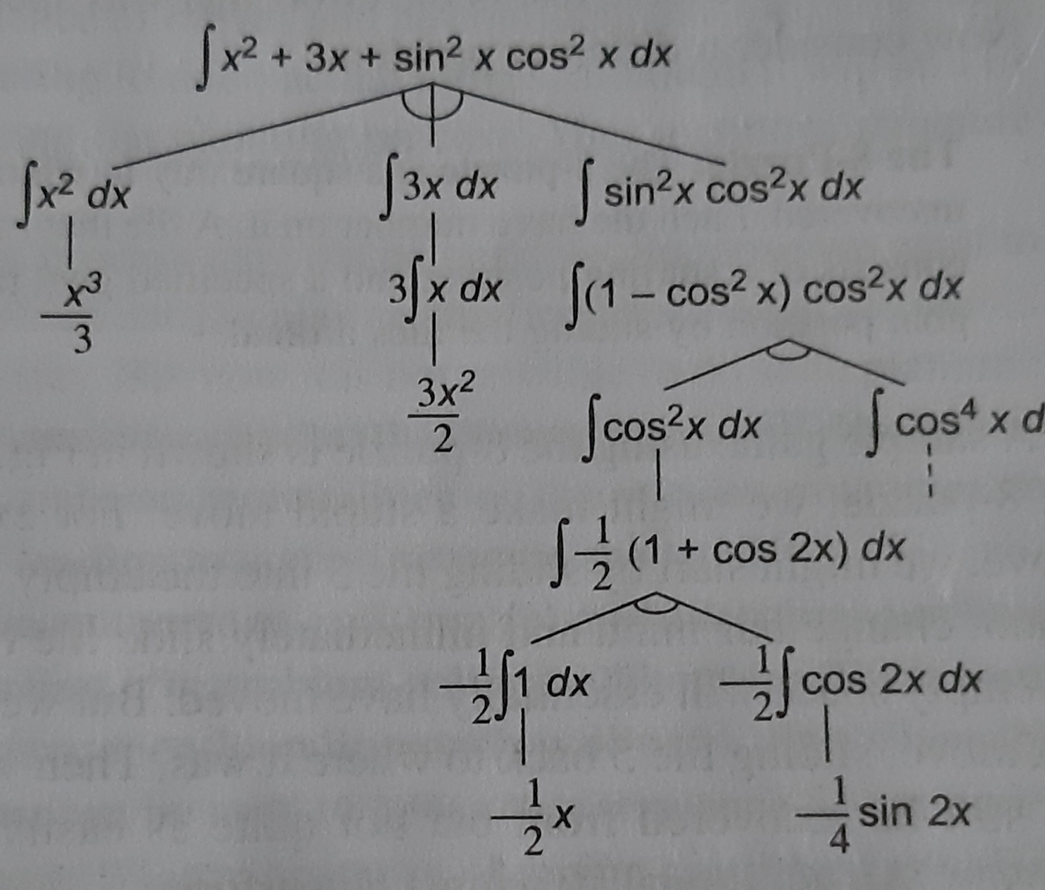
Is the problem decomposable? ∫x² +3x+sin² x cos^{2 x} dx

Slide 68
Block world
CLEAR(x)[block x has nothing on it]→ON(x,Table)[pick up x and put it on table]
CLEAR(x) and CLEAR(y)→ON(x,y)[put x on y]

Slide 69
Can a solution steps be ignored or undone
Ignorable(theorem proving)
Recoverable(8 puzzle)
Irrecoverable(chess)

Slide 70
8 puzzle
Start state
Goal state
2 | 8 | 3
1 | 6 | 4
7 |  | 5
1 | 2 | 3
8 |  | 4
7 | 6 | 5

Slide 71
Is the problem universe predictable
Certain outcome(8 puzzle)→ predicted perfectly, no need of feedback
Uncertain outcome(bridge)→ good probability to lead to solution, plan revision, need feedback

Slide 72
Is a Good solution Absolute or Relative?
FACTS
Marcus was a man
Marcus was Pompeian
Marcus was born in 40 A.D
All men are mortal
All Pompeian died when volcano erupted in 79 A.D
No mortal lives longer than 150 years
It is now 1991 A.D

Slide 73
Answer the Question”Is Marcus alive?” Answer this question by representing facts in predicate logic and use inference methods
1 | Marcus was a man | Axiom 1
4 | All men are motral | Axiom 4
8 | Marcus is mortal | 1,4
3 | Marcus was born in 40 A.D | Axiom 3
7 | It is now 1991 A.D | Axiom 7
9 | Marcus age is 1951 years | 3,7
6 | No mortal lives longer than 150 years | Axiom 6
10 | Marcus is dead | 8,6,9

Slide 74
7 | It is now 1991 A.D | Axiom 7
5 | All Pompeians died in 79 A.D | Axiom 5
11 | All Pompeians are dead now | 7,5
2 | Marcus was a Pompeian | Axiom 2
12 | Marcus is dead | 11,2

Slide 75
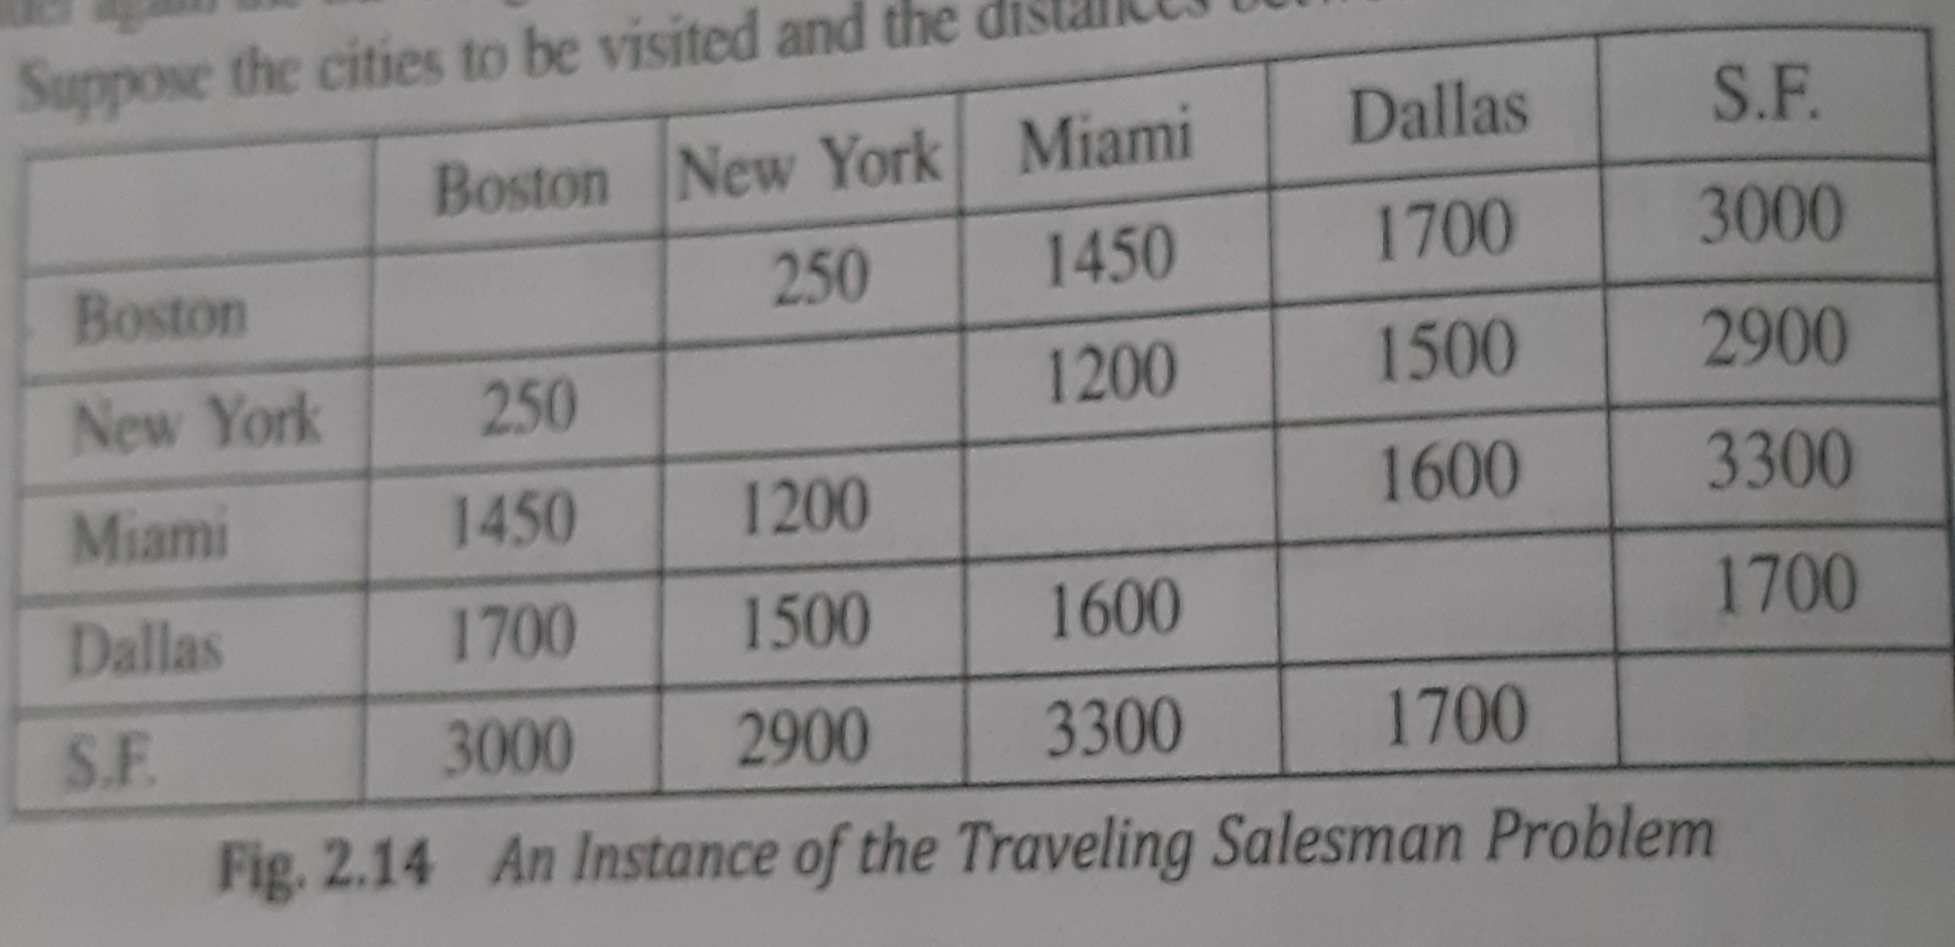
Instance of travelling salesman problem

Slide 76
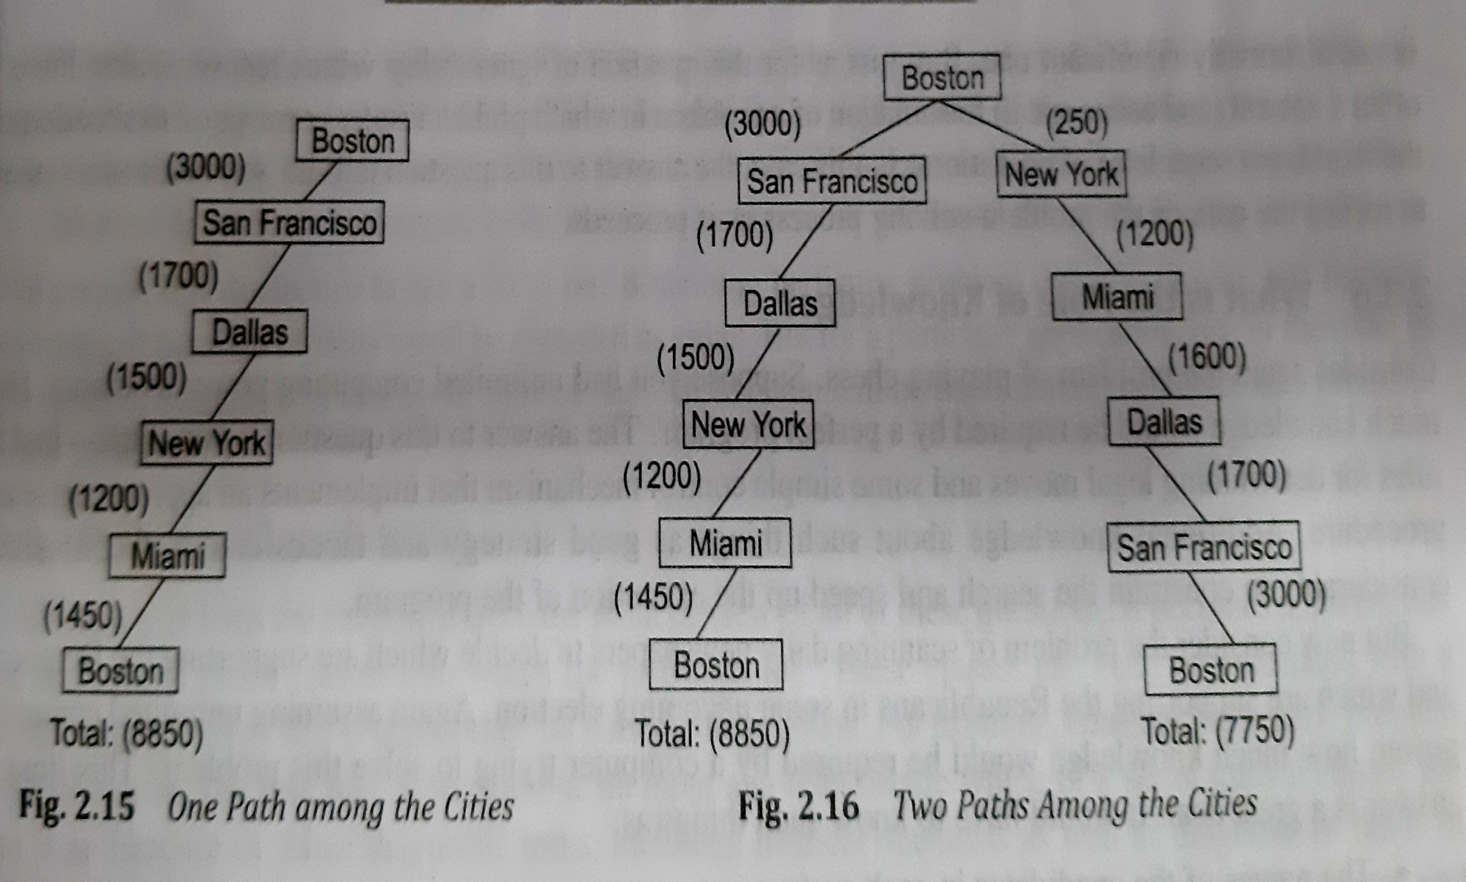
PATH

Slide 77
Is the solution a State or Path?
Natural language understanding➔
“The bank President ate a dish of pasta salad with the fork”.
Water jug problem→final sate(2,0)

Slide 78
What is role of knowledge?
Problem of playing chess
Problem of scanning daily newspaper to decide which are supporting Democrats and Republicans in the upcoming election

Slide 79
Does the task require interaction with a person
Solitary
Conversational

Slide 80
Production System
Can production system like problems be describes by set of characteristics?
What Relationships are there between problem types and types of production system

Slide 81
Production System Characteristics
Monotonic → Application of a rule never prevents the later application of another rule that could also be applied at the time first rule was selected.
Nonmonotonic →in which the previous statement is not true
Partially Commutative →Application of a particular sequence of rules transforms state x into state y, then any permutation of those rules that is allowable also transforms state x into state y
Commutative →both monotonic and partially commutative

Slide 82
Four Categories of Production system
 | Monotonic | Nonmonotonic
Partially commutative | Theorem proving | Robot Navigation
Not partially commutative | Chemical Synthesis | Bridge

Slide 83
Issues in Design of search Programs
Direction in which to conduct the search
How to select applicable rules
How to represent nodes of search process
Search tree versus search graph

Slide 84
Algorithm: Check Duplicate node
Examine the set of nodes that have been created so far to see if the new node already exist
If it does not simply add it to graph just as a tree
If it does already exist then do the following
Set the node that is being expanded to point to already existing node corresponding to its successor rather than to new one
If you are keeping track of the best path to each node ,then check to see if new path is better or worse than the old one. If worse do nothing . If better record the new path as correct path to use to get to the node

Slide 85
Additional Problems
Missionaries and cannibals problem
Tower of hanoi
Monkey and Bananas problem
Cryptharithmetic problem

Slide 86
Algorithm-Generate and test
Generate the possible solution. For some problems it means generating a particular point in the problem space. For others it mean generating a path from start state
Test to see if this is actually a solution by comparing the chosen point or endpoint of the chosen path to the set of acceptable goal states
If a solution has been found quit. Otherwise return to step 1

Slide 87
If the generation of possible solutions is done systematically, then this procedure will find a solution if one exists. If the problem space is large, may be very long time
Systematic generate and test can be implemented as depth first search tree with backtracking
Example: Puzzle consists of four six-sided cubes, with each side painted one of the four color . A solution to puzzle consists of arrangement of cubes in a row such that on all four sides of the row one block face of each color showing
Example of successful AI program is DENDRAL uses a strategy called plan-generate-test which is a combination of planning and generate –test .

Slide 88
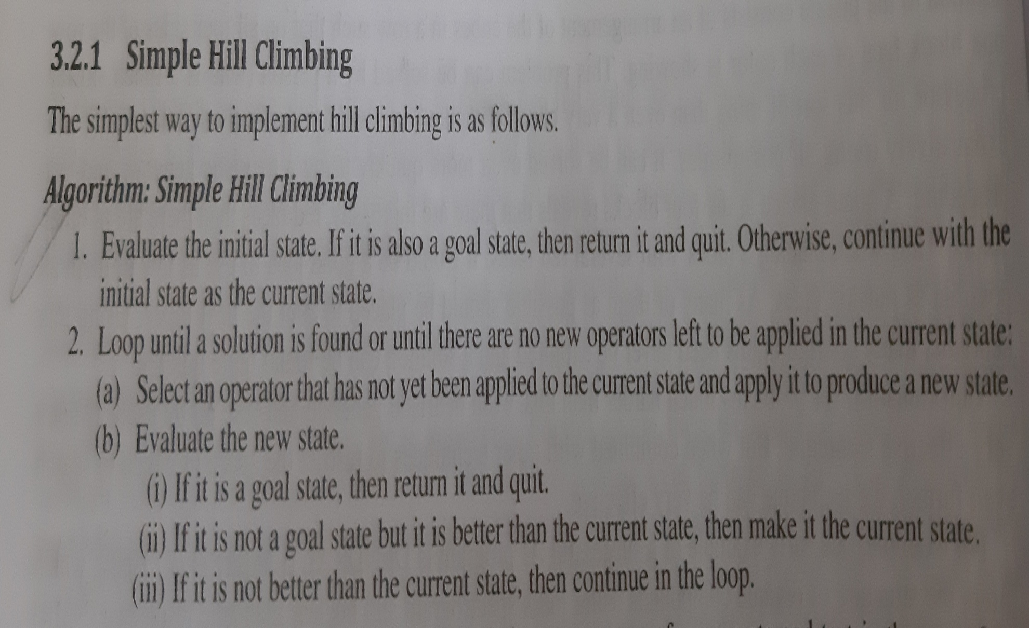
Algorithm Hill climbing

Slide 89
Hill Climbing
Hill Climbing is a variant of generate-and-test in which feedback from the test procedure is used to help the generator decide which direction to move in search space
Hill Climbing is used when a good heuristic function is available for evaluating states but no other useful knowledge is available
For absolute solutions, hill climbing can terminate whenever goal state is reached. For relative solution, there is no prior goal state, it makes sense to terminate hill climbing when there is no reasonable alternative state to move to

Slide 90
Difference between hill climbing and generate and test is use of evaluation function to inject task specific knowledge into the control process

Slide 91
Steepest Ascent Hill Climbing(Gradient search)
Variation of hill climbing that considers all moves from the current state and selects the best one as next state

Slide 92
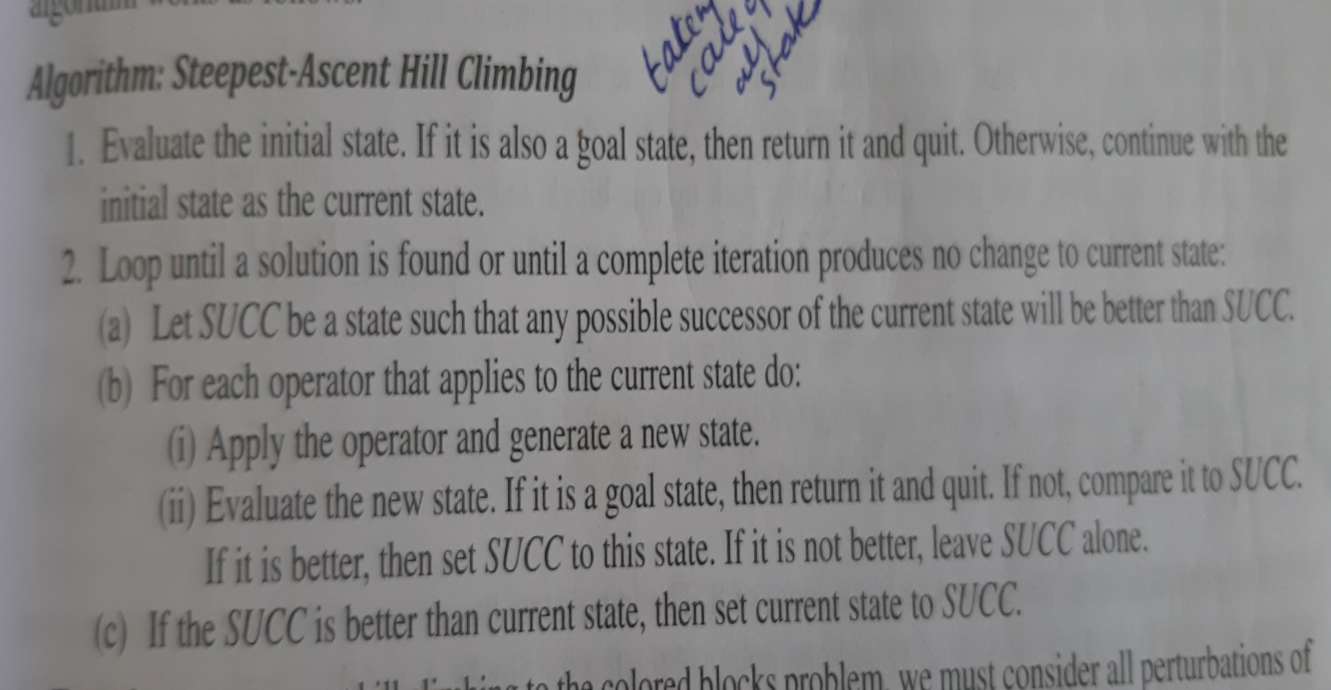
Algorithm

Slide 93
Local maximum is a state that is better than all its neighbors but not better than some other states farther away
Solution:Backtrack to some earlier node and go in another direction
Plateau is flat area of search space in whole set of neighboring states have same value
Solution:Make a big jump in some direction to try to get to a new section of search space
Ridge is a special kind of local maximum. It is area of search space that is higher than surrounding areas and that itself a slope. It is impossible to traverse a ridge by single moves
Solution: Apply two or more rules before doing a test. This corresponds to move in several direction at once

Slide 94
Hill Climbing is local method ,it decides what to do next by looking at immediate consequences of its choice

Slide 95
Hill Climbing Problem
Initial state final state
A
H
G
F
E
D
C
B
H
G
F
E
D
C
B
A

Slide 96
THREE POSSIBLE MOVES
A
H
G
F
E
D
C
B
G
F
E
D
C
B
G
F
E
D
C
B
H
A
A
H
(A)
(B)
( C )

Slide 97
Local: Add one point for every block that is resting on a thing it is supposed to be resting on. Subtract one point for every block that is sitting on the wrong thing
Goal state has score 8
From the initial state(4) move A on to the table..From the new state(6) there are three possible moves leading to three sates which has score
(A)=4,(B)=4,( C )=4
Hill climbing will halt here, bcos all states have lower scores than current state

Slide 98
Suppose we modify heuristic function as follows
Global: For each block that has correct support structure, add one point for every block in the support structure. For each block that has incorrect support structure, subtract one point for every block in the existing support structure
Initial state has -28,Goal state has 28
Moving A to table yields score of -21
Three new states has following score
(A)=-28,(B)=-16,(C )=-15
Move C is the correct move

Slide 99
Simulated Annealing
It is a computational process which is patterned after physical process of annealing, in which physical substances such as metals are melted and then gradually cooled until some solid state is reached
Goal of this process is to produce minimal energy final state
Actually we describe valley descending rather than hill climbing

Slide 100
Physical substances usually move from higher energy to lower ones, so valley descending occurs naturally. But there is some probability that transition to a higher energy state will occur. This probability is given by
Function p=e^{-∆E/KT}
∆E is a positive change in energy level
T is a temperature
k is Boltzmann constant

Slide 101
Rate at which system is cooled is called annealing schedule
∆E represents not only change in energy but generally change in the objective(heuristic) function
Since it is analogous process,where E and T are artificial ,incorporate k into T, hence the formula is
p=e^{-∆E/T}

Slide 102
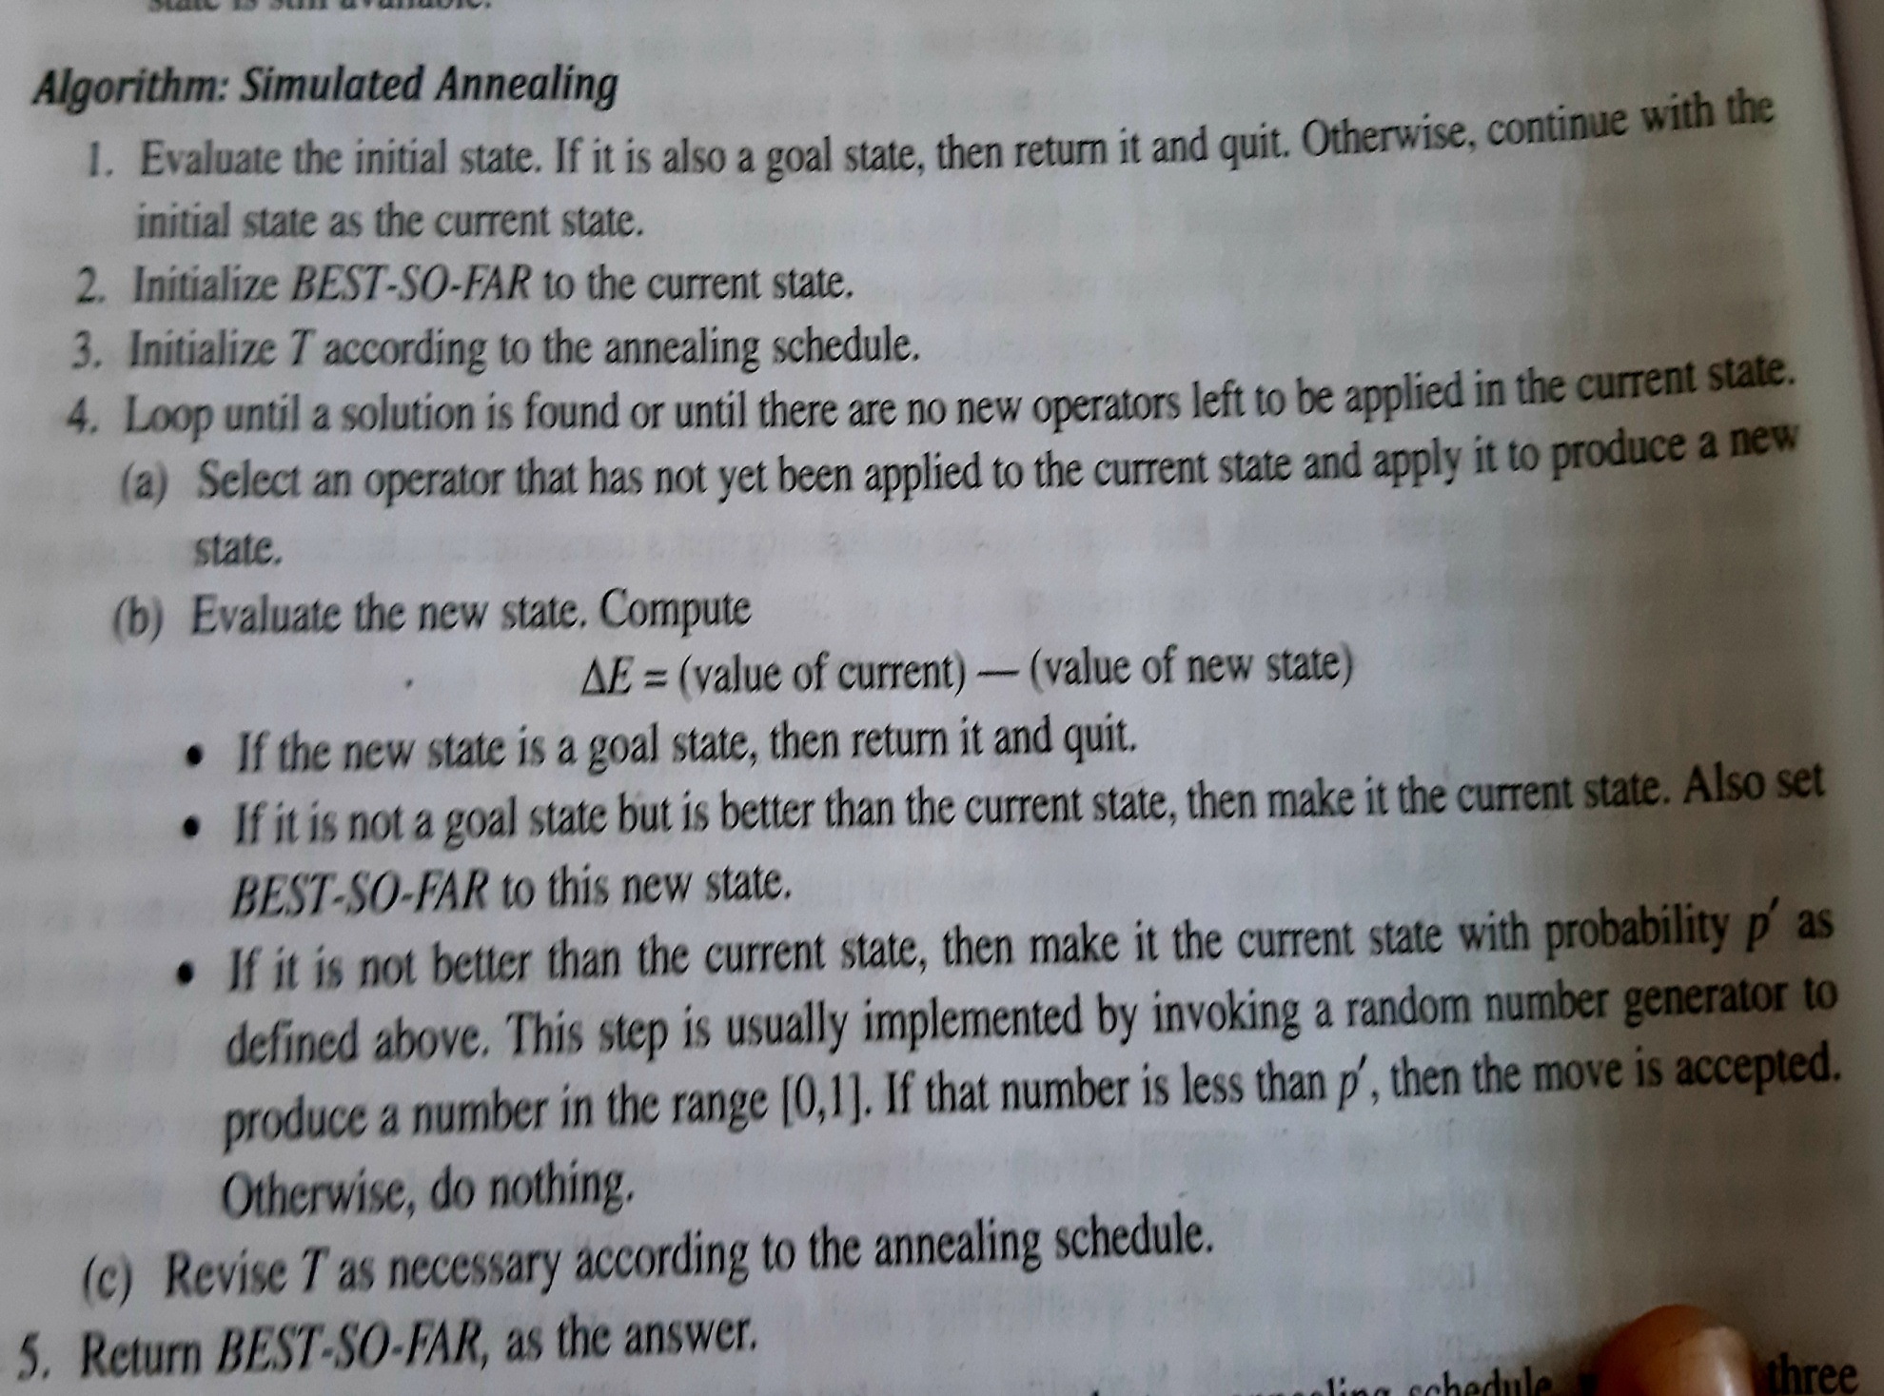

Slide 103
Differences between hill climbing and simulated annealing
Annealing schedule must be maintained
Move to worse states may be accepted
Maintain in addition to current state , best state found so far
Annealing schedule has three components
Initial value to be used for temperature
When the temperature has to be reduced
Amount by which temperature will be reduced each time it is changed

Slide 104
Best First Search
It is method of combining advantages of both depth first search and breadth first search into a single method.
One way of combining the two is to follow a single path at a time ,but switch paths whenever some competing path looks more promising than current one does
It is called as a OR graph ,since each of its branches represents an alternative problem solving path

Slide 105
To implement ,we need two list of nodes:
OPEN-nodes that have been generated and had heuristic function applied to them but which have not yet been examined.
CLOSED-nodes that have been already been examined
We need a heuristic function that estimates the merit of each node we generate. Call it as f’
f=g+h’
g is a measure of cost of getting from initial state to current node
h’ is a measure additional cost of getting from current node to goal state
f’ is cost of getting form initial state to goal node along the path that generated current node

Slide 106
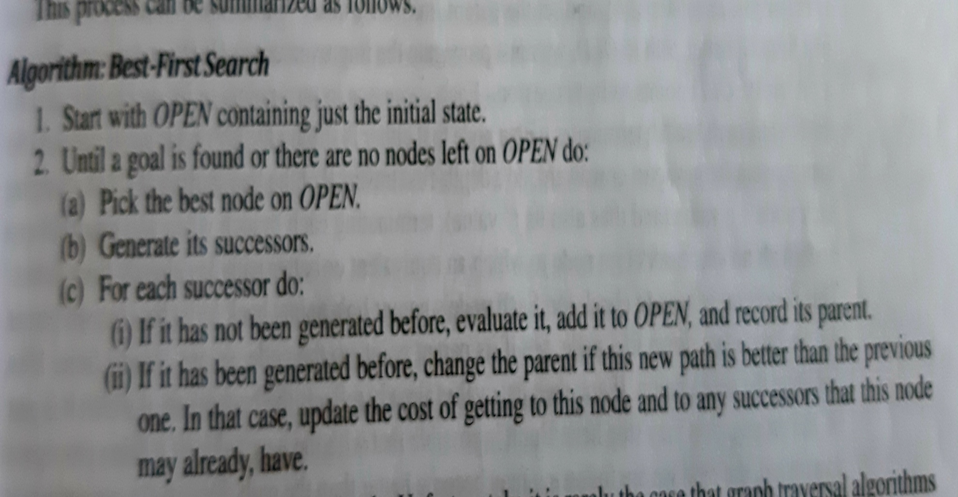
Best first search algorithm

Slide 107
A* Algorithm
1 Start with OPEN containing only the initial node. Set node g value to 0,h value to whatever it is. Set CLOSED to empty list
Until goal node is found ,repeat the following: If there are nodes on OPEN, report failure. Otherwise pick the node on OPEN with lowest f’ value. Call it BESTNODE. Remove it from OPEN. Place it on CLOSED. See if the BESTNODE is goal node. If so exit and report a solution. Otherwise generate successors of BESTNODE but do not set BESTNODE to point to them yet. For each successors do the following:

Slide 108
Set SUCCESSOR to point back to the BESTNODE
Compute g(SUCCESSOR)=g(BESTNODE)+cost of getting from BESTNODE to SUCCESSOR.
See if the SUCCESSOR is same as any node on OPEN. If so call the node OLD. Since this node already exists, throw the SUCCESSOR away and add OLD to the list of BESTNODE successors. Decide whether OLD parent link must be reset to point to BESTNODE. If the OLD is cheaper do nothing. If the SUCCESSOR is cheaper then reset OLD parent link to point to BESTNODE, record the new cheaper path in g(OLD) and update f^{’ (} OLD)

Slide 109
d) If the SUCCESSOR was not on OPEN, see if it is on CLOSED. If so call node on CLOSED OLD and add OLD to list of BESTNODE successors. Check to see if the new path or old path is better just as step2(C) and set parent link and g and f’ values appropriately. If we have found a better path to OLD we must propagate the improvement to OLD successors
e)If SUCCESSOR was not already either on OPEN or CLOSED,then put it on OPEN and add it to the list of BESTNODE successors.Compute f’ (SUCCESSOR)=g(SUCCESSOR)+ h’(SUCCESSOR)

Slide 110
Role of the function.A* Algorithm can be used in finding minimal cost overall path or any path as quickly as possible
h’ underestimates h and h’ overestimates h
We can implement A* for tree also,by not bothering to check whether the node is in OPEN or CLOSED

Slide 111
Agenda driven search
Agenda is list of tasks a system could perform
Each task has two things
List of reason why the task has been proposed(justification)
Rating representing overall weight of evidence suggesting that task would be useful
Agenda driven search good way to implement monotonic production system and poor way to implement nonmonotonic production system

Slide 112
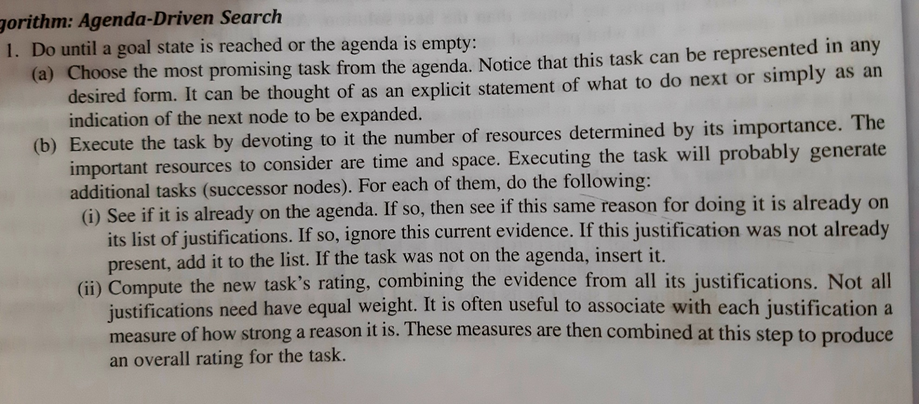
Algorithm Agenda driven search

Slide 113
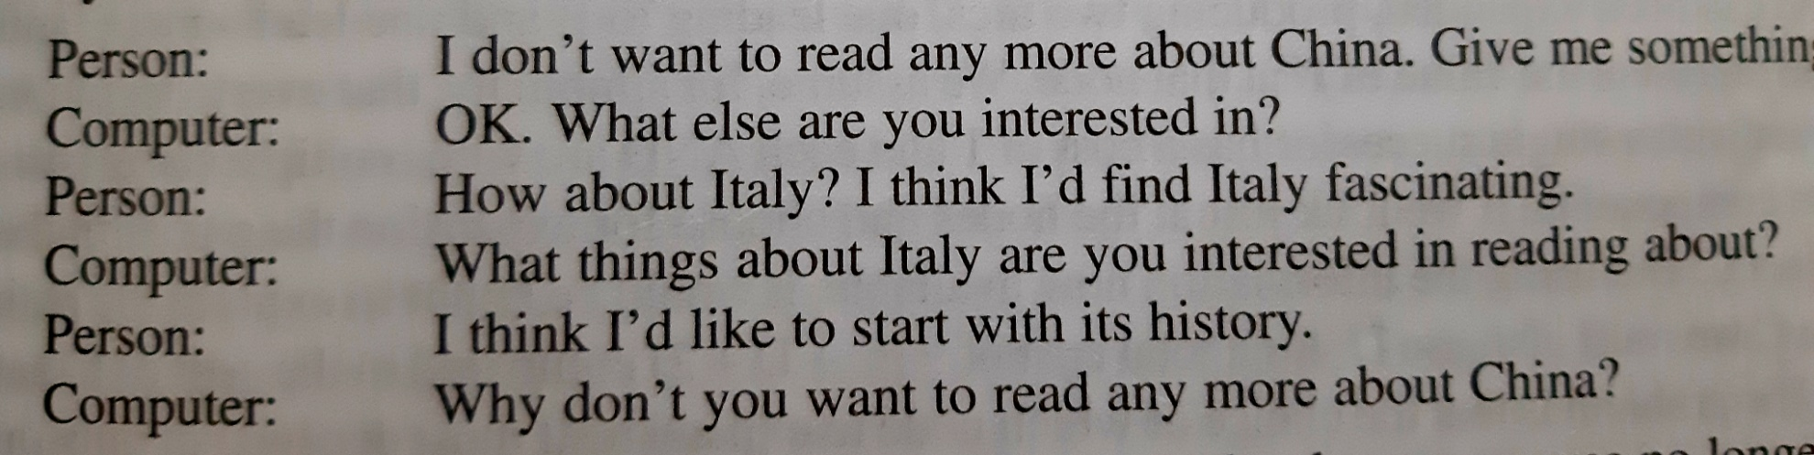
Dialogue

Slide 114
AND-OR Graph
It is useful for representing the solution of the problem than can be solved by decomposing them into a smaller problems , all of which must then be solved. It generates an arc called AND arc

Slide 115
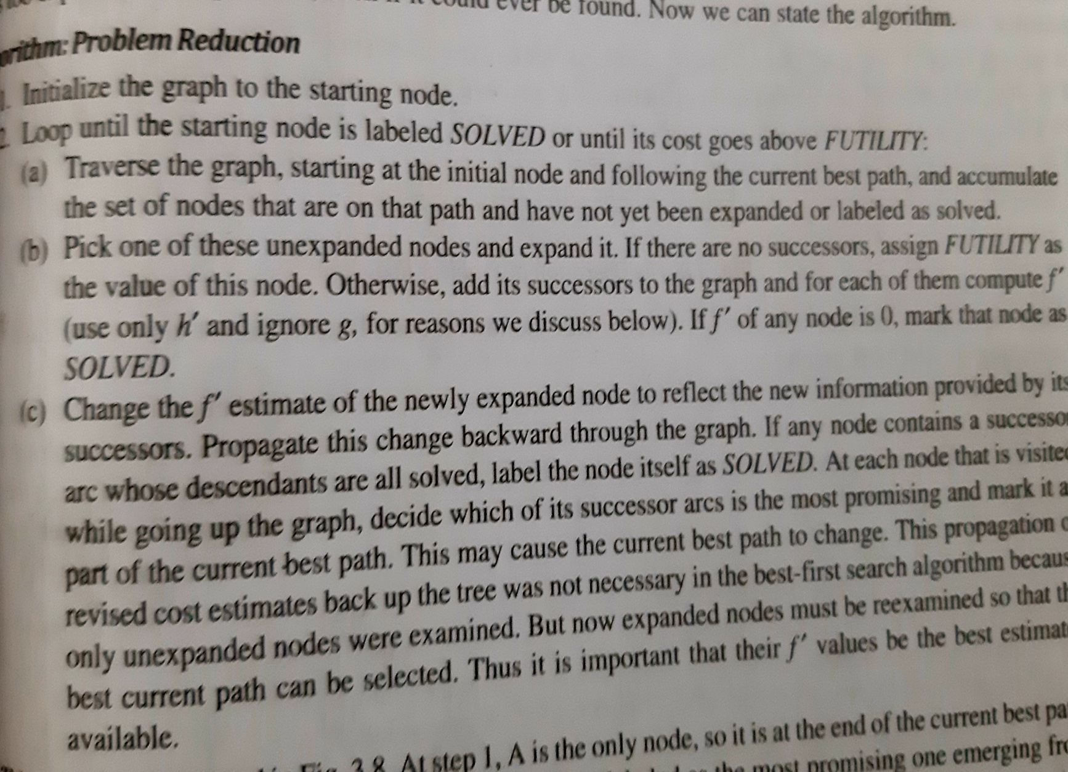

Slide 116
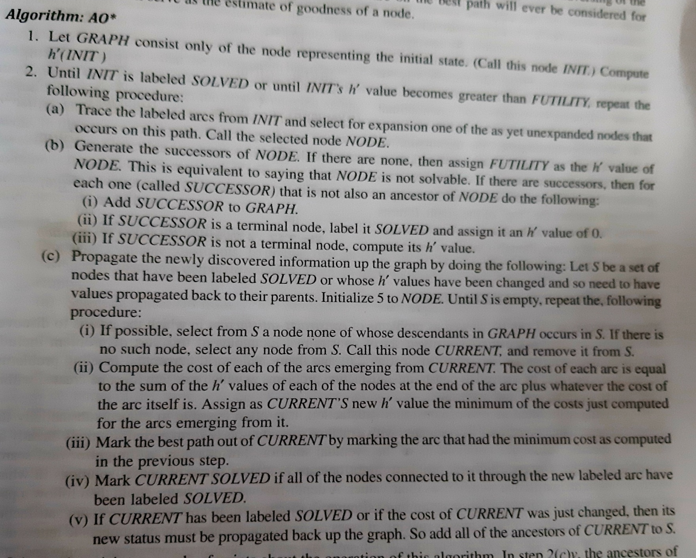

Slide 117
Constraint Satisfaction
Goal is to discover some problem state that satisfies the given set of constraints.ex:cryptharithmetic puzzle
It is search procedure that operates in space of constraint sets.
It is a two step process. First constraints are discovered and prorogated. Second step is to strengthen the constraint by guessing.

Slide 118
It requires two kind of rules. Fisrt rule that define way the constraint validly propagated and rules that suggest guesses when necessary
Constraint satisfaction terminates for two reasons. First contradiction may be detected. Second propagation has run out of steam and no further changes can be made

Slide 119
Cryptharithmetic problem
Problem:
SEND
MORE
MONEY
Initial state: No two letters have same value, sum of digits must be shown in problem.
Goal state: All letters have been assigned a digit in such a way that all initial constraints are satisfied

Slide 120
Constraints are propagated using rules that correspond to the properties of arithmetic
A value is guessed for some letter whose value is not been determined

Slide 121
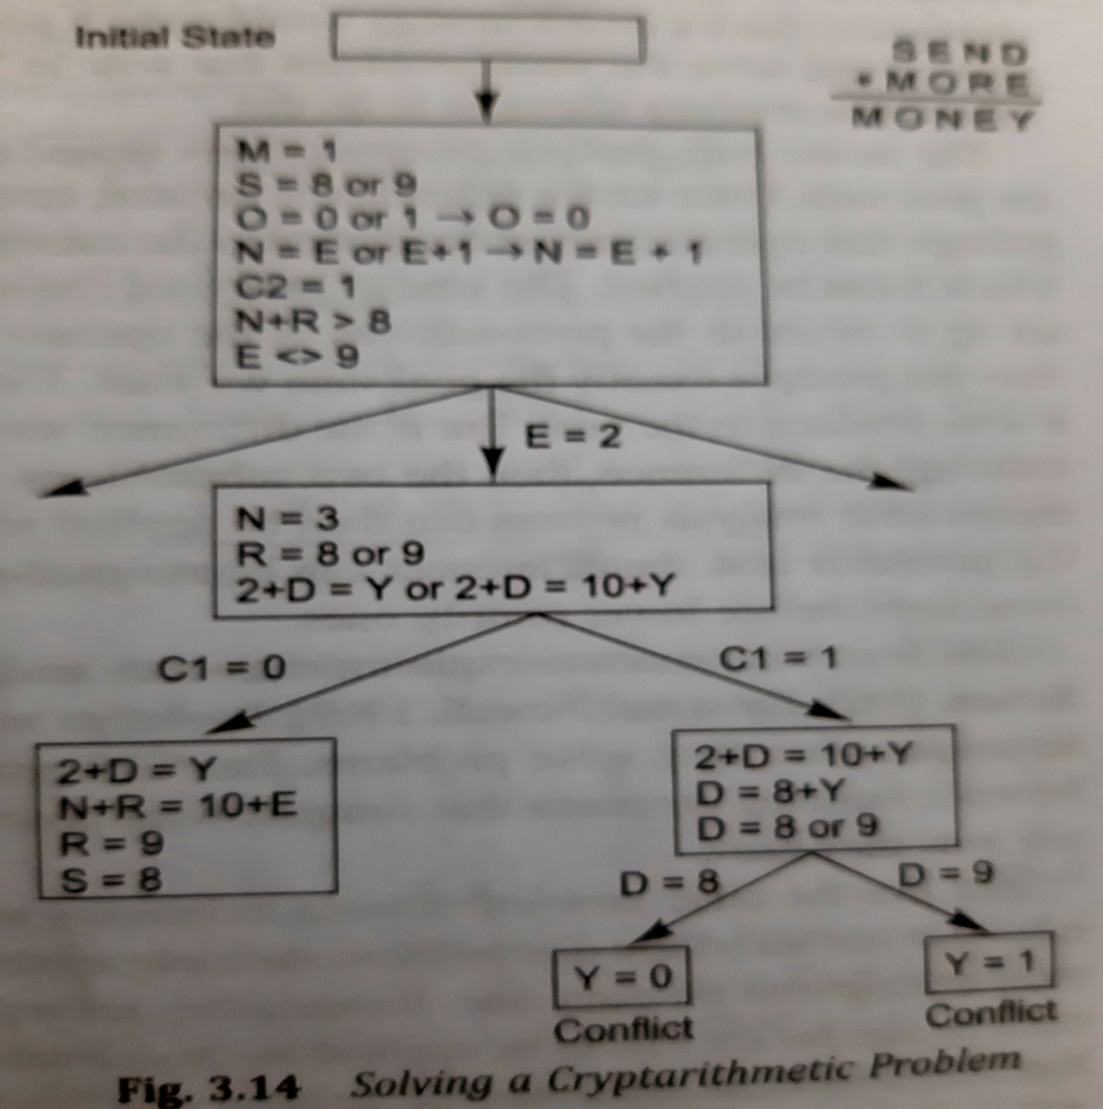

Slide 122
Mean end analysis
Mixed strategy would make it possible to solve major parts of problem first and go back and solve small problems that arise in gluing big pieces. This technique is called mean end analysis
Mean end analysis centers around detection of difference between current sate and goal state
Backward chaining in which operators are selected and then subgoals are setup to establish the precondition of operators is called subgoaling

Slide 123
Left side of the rule describes the conditions that should be met for the rule to be applicable and right side describes those aspects of problem state that will be changed by application of rule
Robot were given the problem of moving a desk with two things on it form one room to another

Slide 124
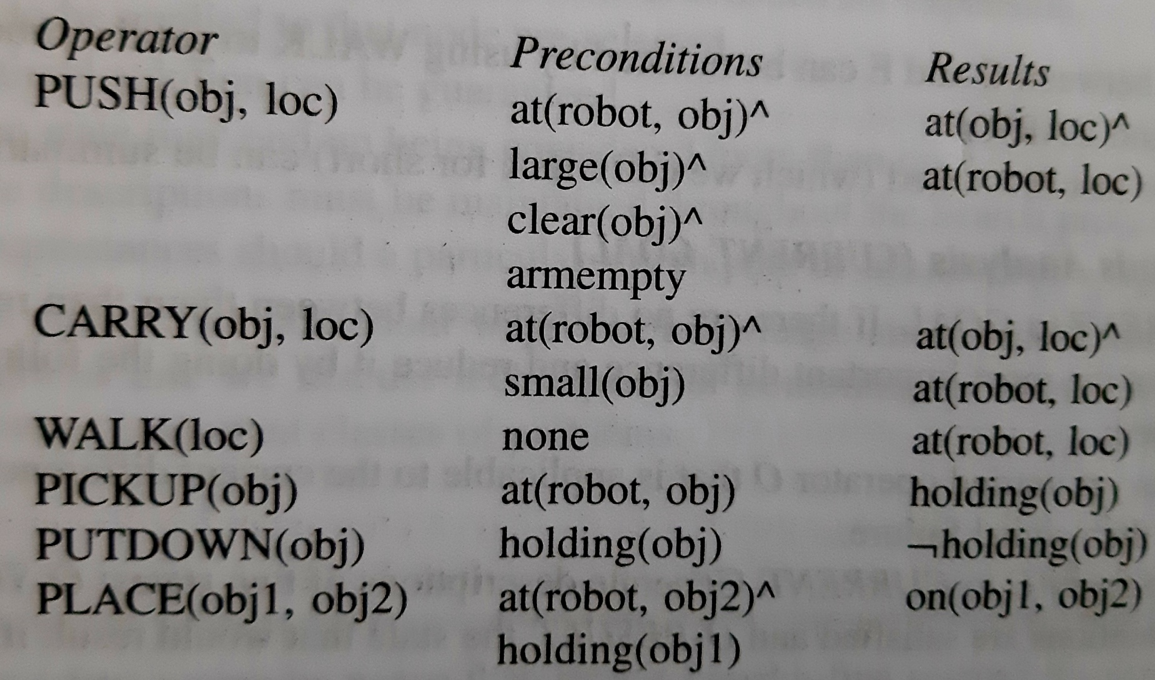

Slide 125
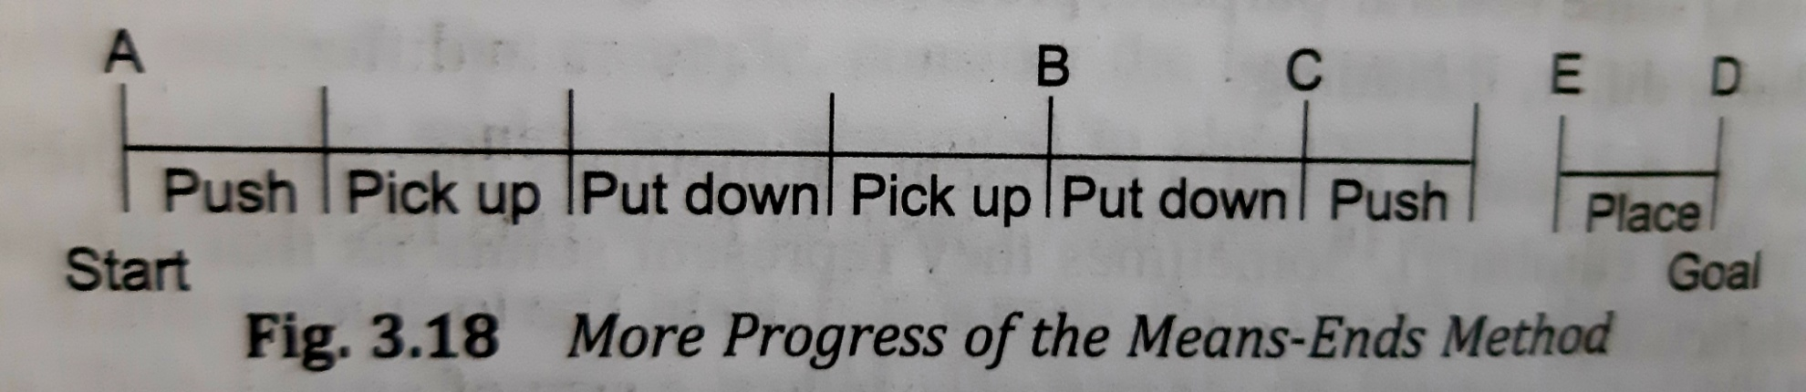

Slide 126
